Slide 1

Envirotyping
Raghu Jana
R.Jana@skoltech.ru

Slide 2



G x E Interaction

Slide 3







Environmental Covariables
Latitude
Longitude
Elevation
Mean daily temperature
Min. temp. of coldest month
Max. temp of hottest month
Ecoregion
Seasonality
Max. of wet season
Intensity & Duration
Soil mineral composition
Soil texture
Soil structure
Growing Degree Days (GDD)
Incident radiation
Day length
Soil chemical composition
Organic material
pH
Soil moisture
Pest/disease potential
Evapotranspiration

Slide 4
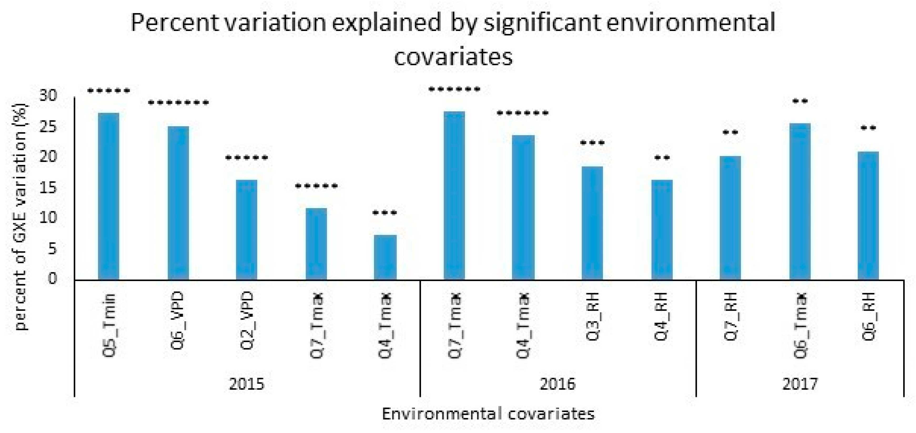
Environmental Covariables
Madhumal et al. Genotype-by-Environment Interaction Effects under Heat Stress in Tropical Maize. Agronomy. 2020; 10(12):1998. https://doi.org/10.3390/agronomy10121998

Slide 5
What is Envirotyping/Enviromics?
Envirotype : All environmental factors that can potentially affect plant growth and yield
Envirotyping : Process of determining and measuring envirotypes
Enviromics : Study of environmental conditions that affect plants and/or animals

Slide 6
Why Enviromics?
Genotype × Environment interaction
Understand sources of environmental dissimilarity
Assess and recommend suitable genotypes
For current and projected climates
Rate quality of environment

Slide 7










Envirotyping
Dynamic
Temperature
Rainfall
Soil Moisture
Envirome
Envirotype
Land Use
Topography
Static
Soil Type

Slide 8
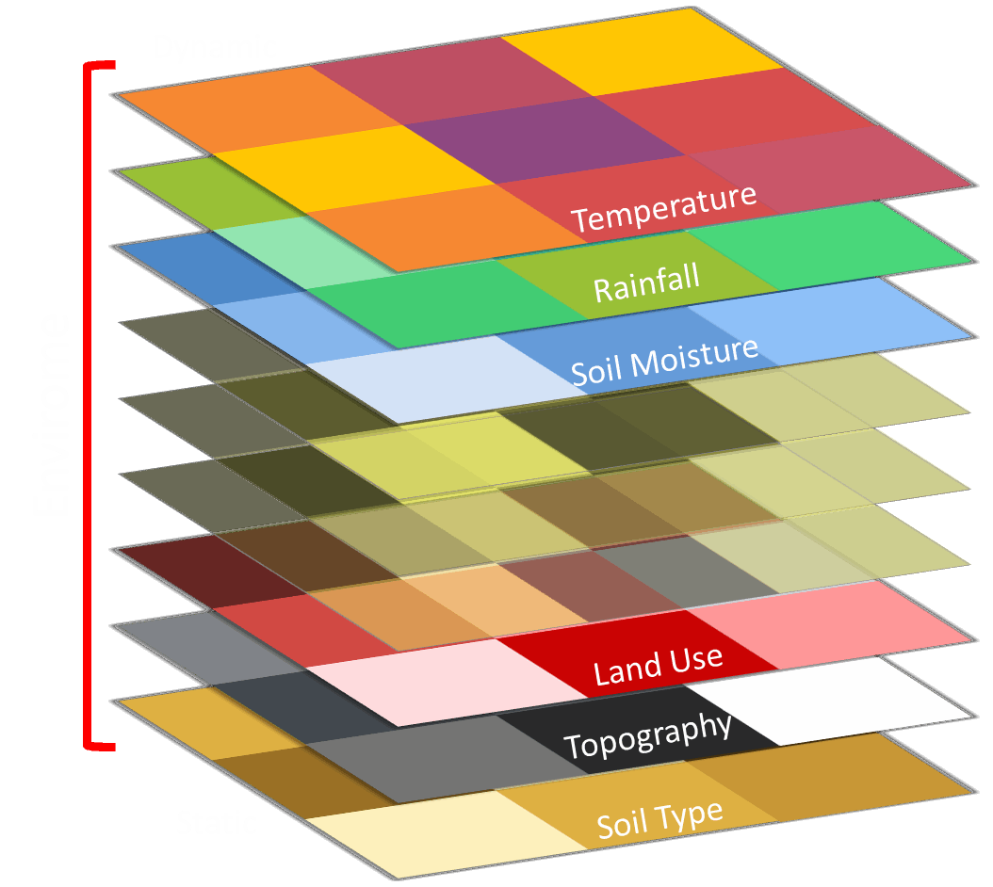
Envirotyping
Holistic view of environmental factors
Interdependency of factors
Understand sources of environmental (dis)similarity
Efficient identification of experimental sites

Slide 9
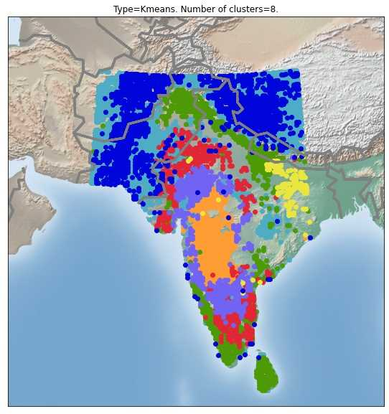
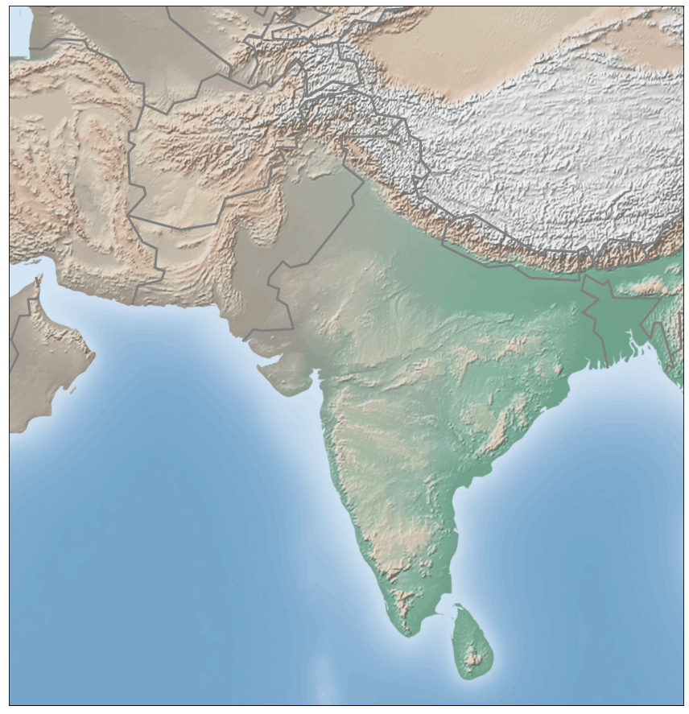
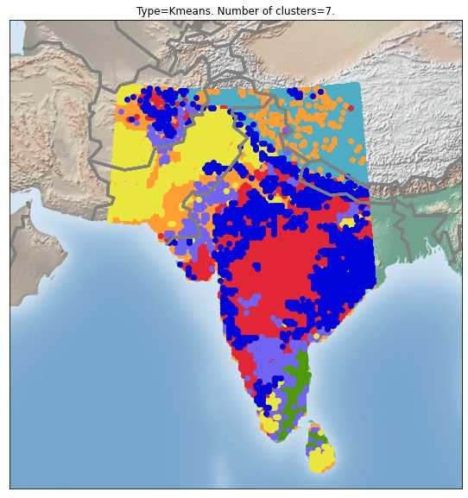
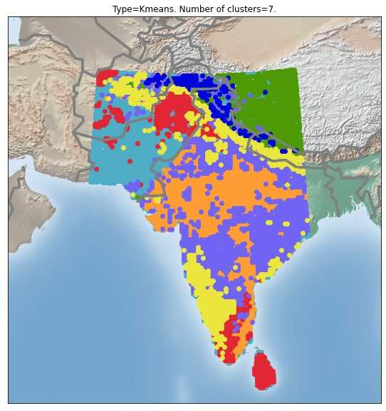
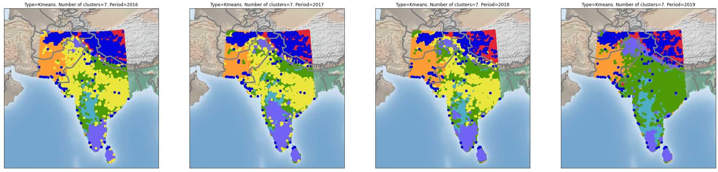




How Envirotyping Helps
2016
2017
2018
2019
30 days
365 days
Notes:
Each dot represents 25km

Slide 10
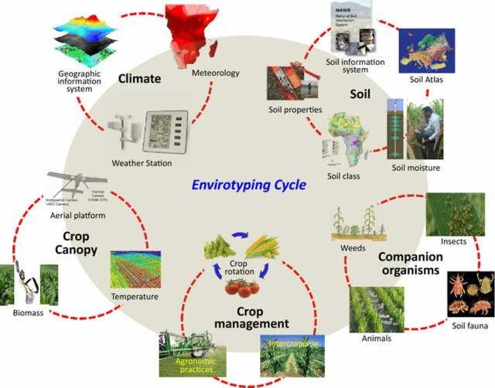
Factor Grouping
Xu, Y. Envirotyping for deciphering environmental impacts on crop plants. Theor Appl Genet 129, 653–673 (2016). https://doi.org/10.1007/s00122-016-2691-5
Notes:
Environmental factors can be classified into five major groups, climate, soil, crop canopy, crop management and companion organisms, each containing several subgroups that describe important environmental factors affecting plant growth and development.

Slide 11
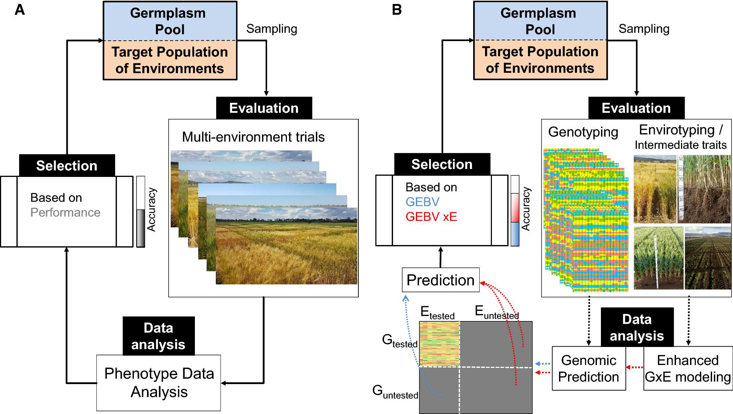
Envirotyping and Modern Plant Breeding
(Modern)
(Conventional)

Slide 12
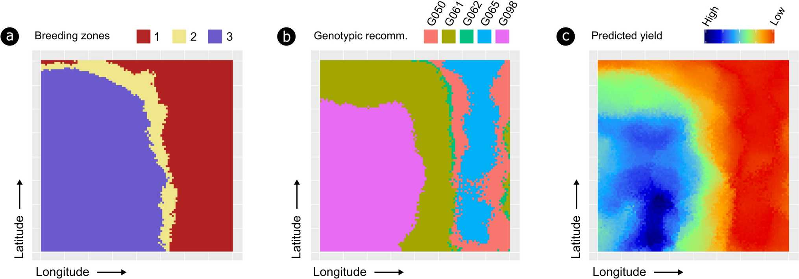
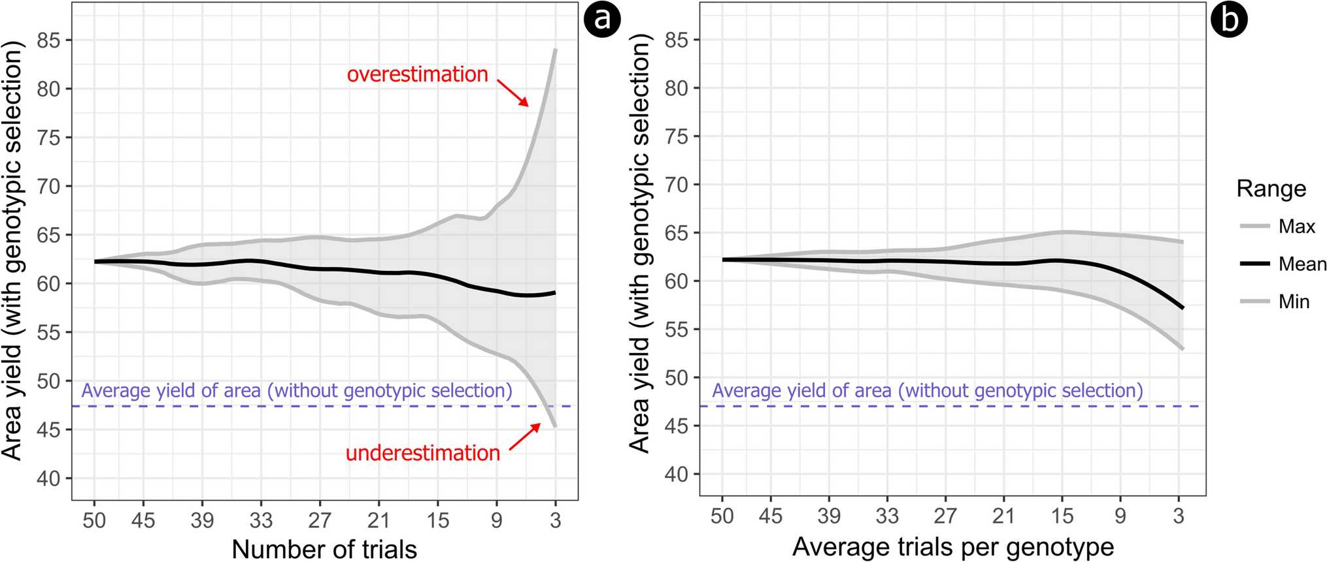
Envirotyping for Selection
Resende, R.T., Piepho, HP., Rosa, G.J.M. et al. Enviromics in breeding: applications and perspectives on envirotypic-assisted selection. Theor Appl Genet 134, 95–112 (2021). https://doi.org/10.1007/s00122-020-03684-z

Slide 13
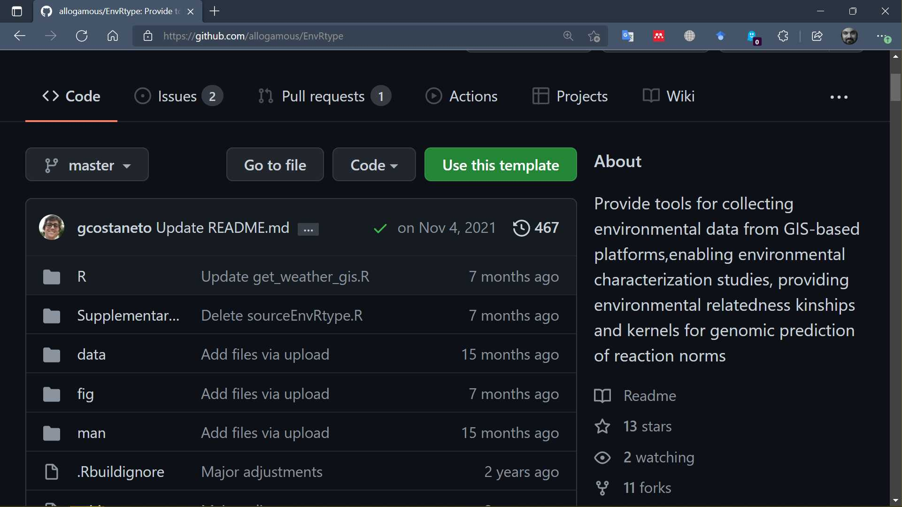
Envirotyping Packages - EnvRtype
https://github.com/allogamous/EnvRtype

Slide 14
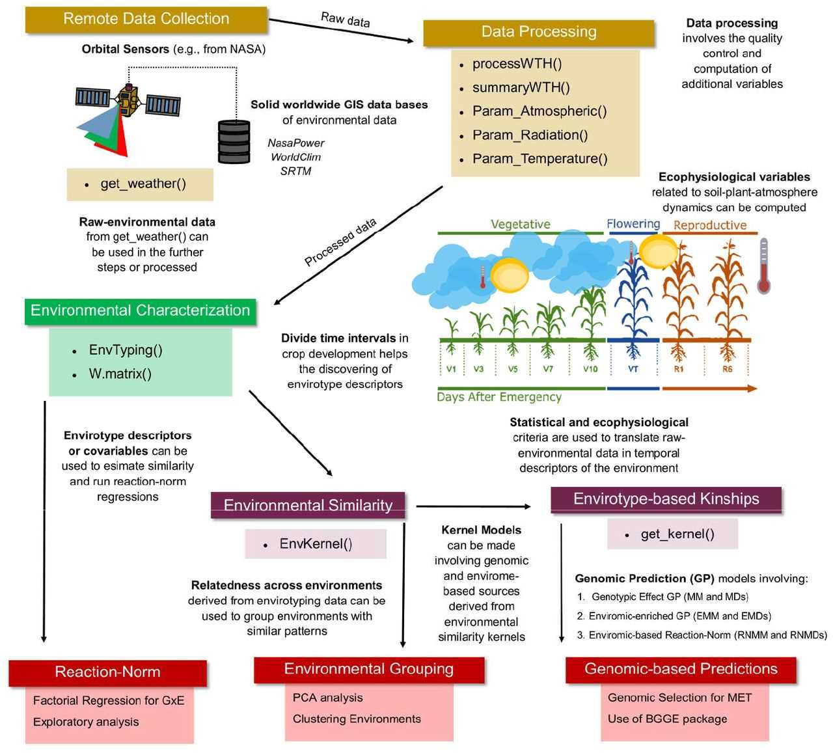
Envirotyping Packages - EnvRtype
https://www.biorxiv.org/content/10.1101/2020.10.14.339705v1.full

Slide 15
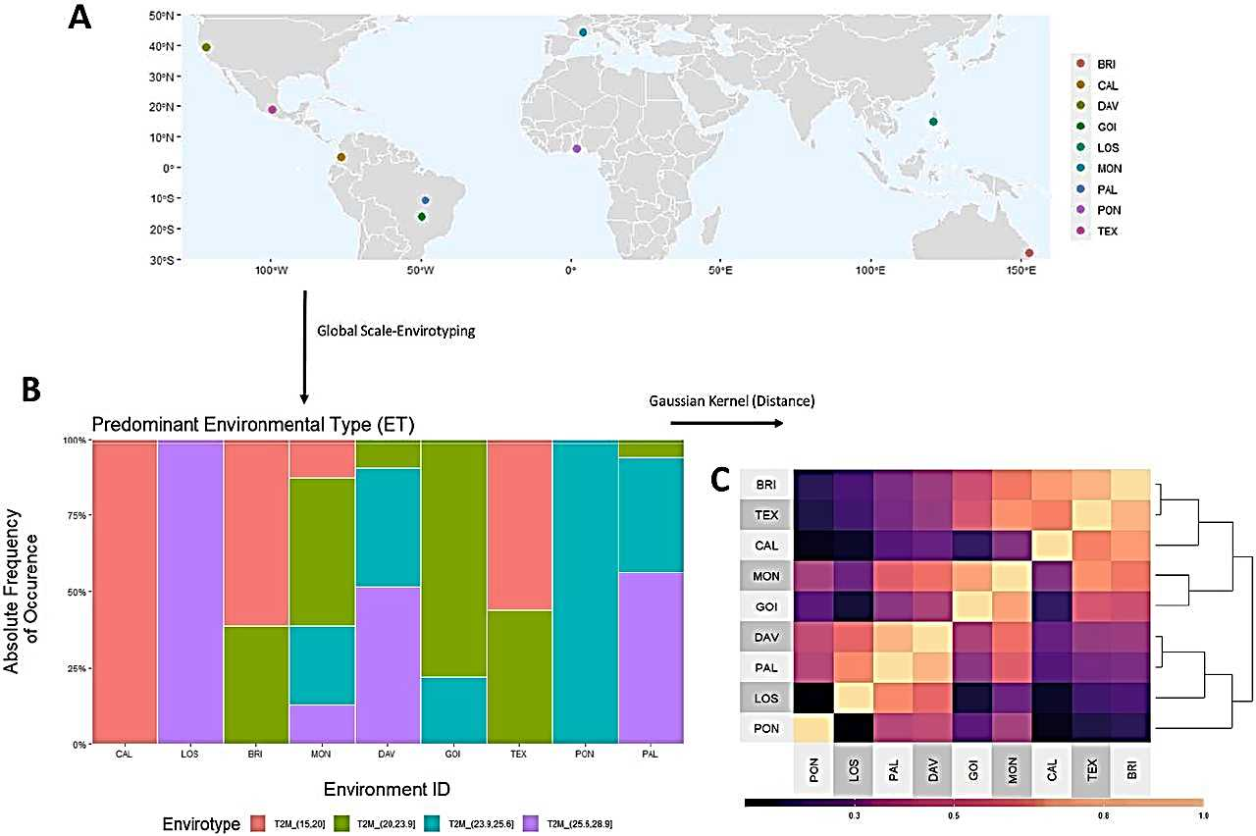
Envirotyping Packages - EnvRtype

Slide 16
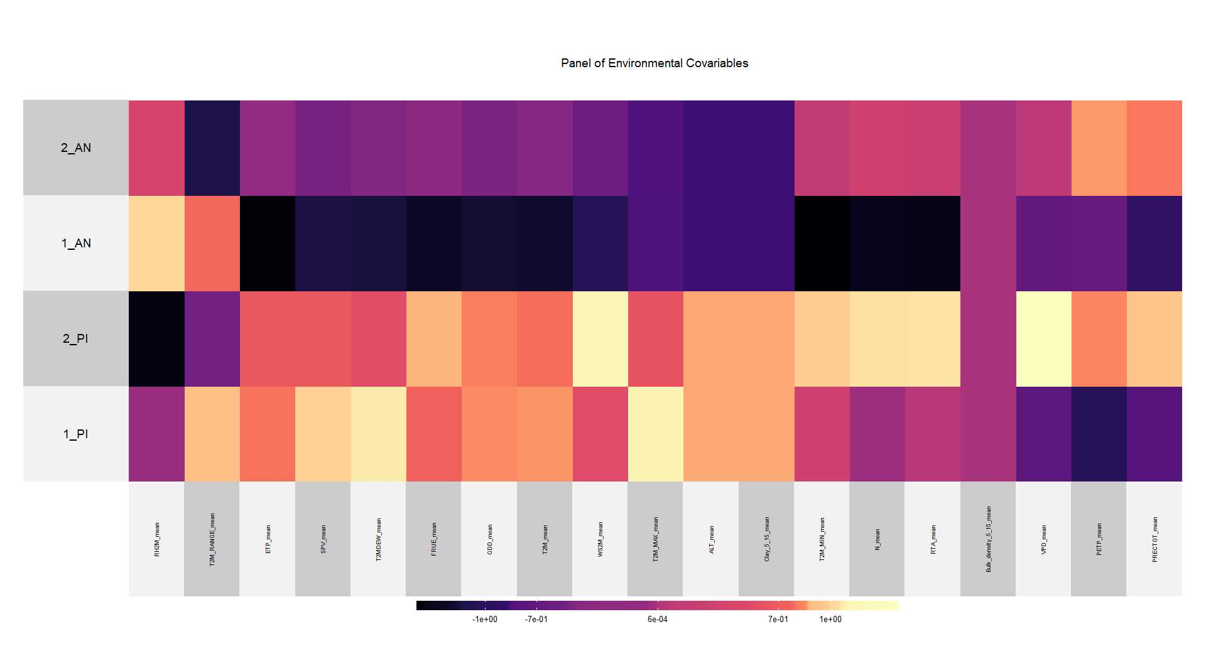
Envirotyping Packages - EnvRtype

Slide 17
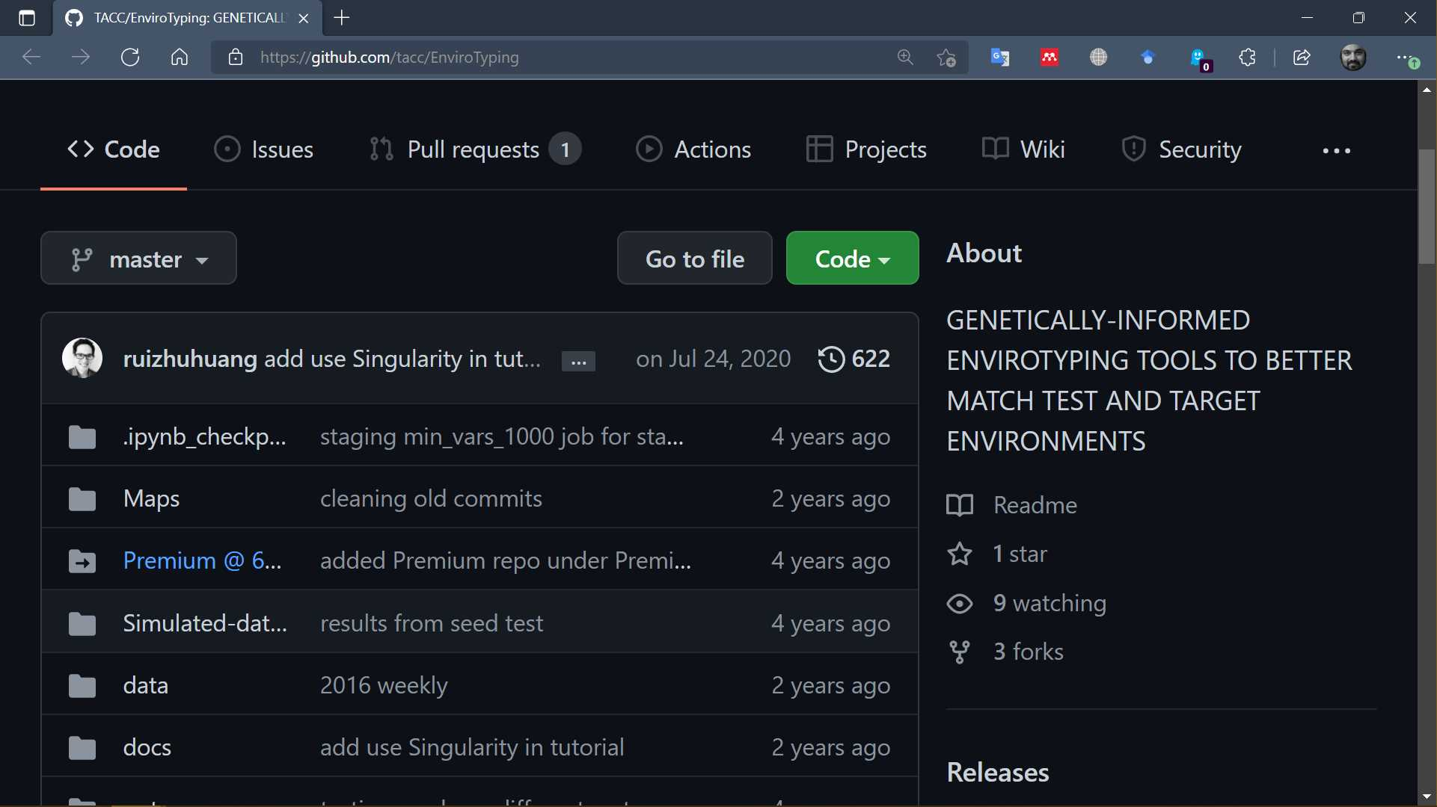
Envirotyping Packages – TACC EnviroTyping
https://github.com/tacc/EnviroTyping

Slide 18
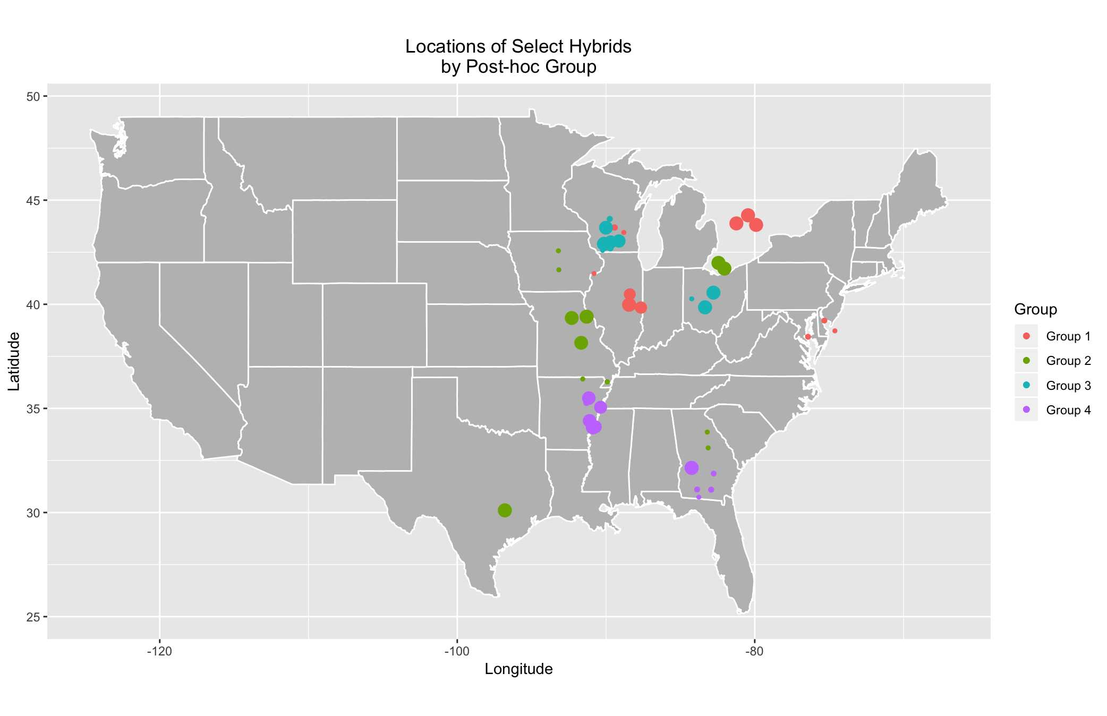
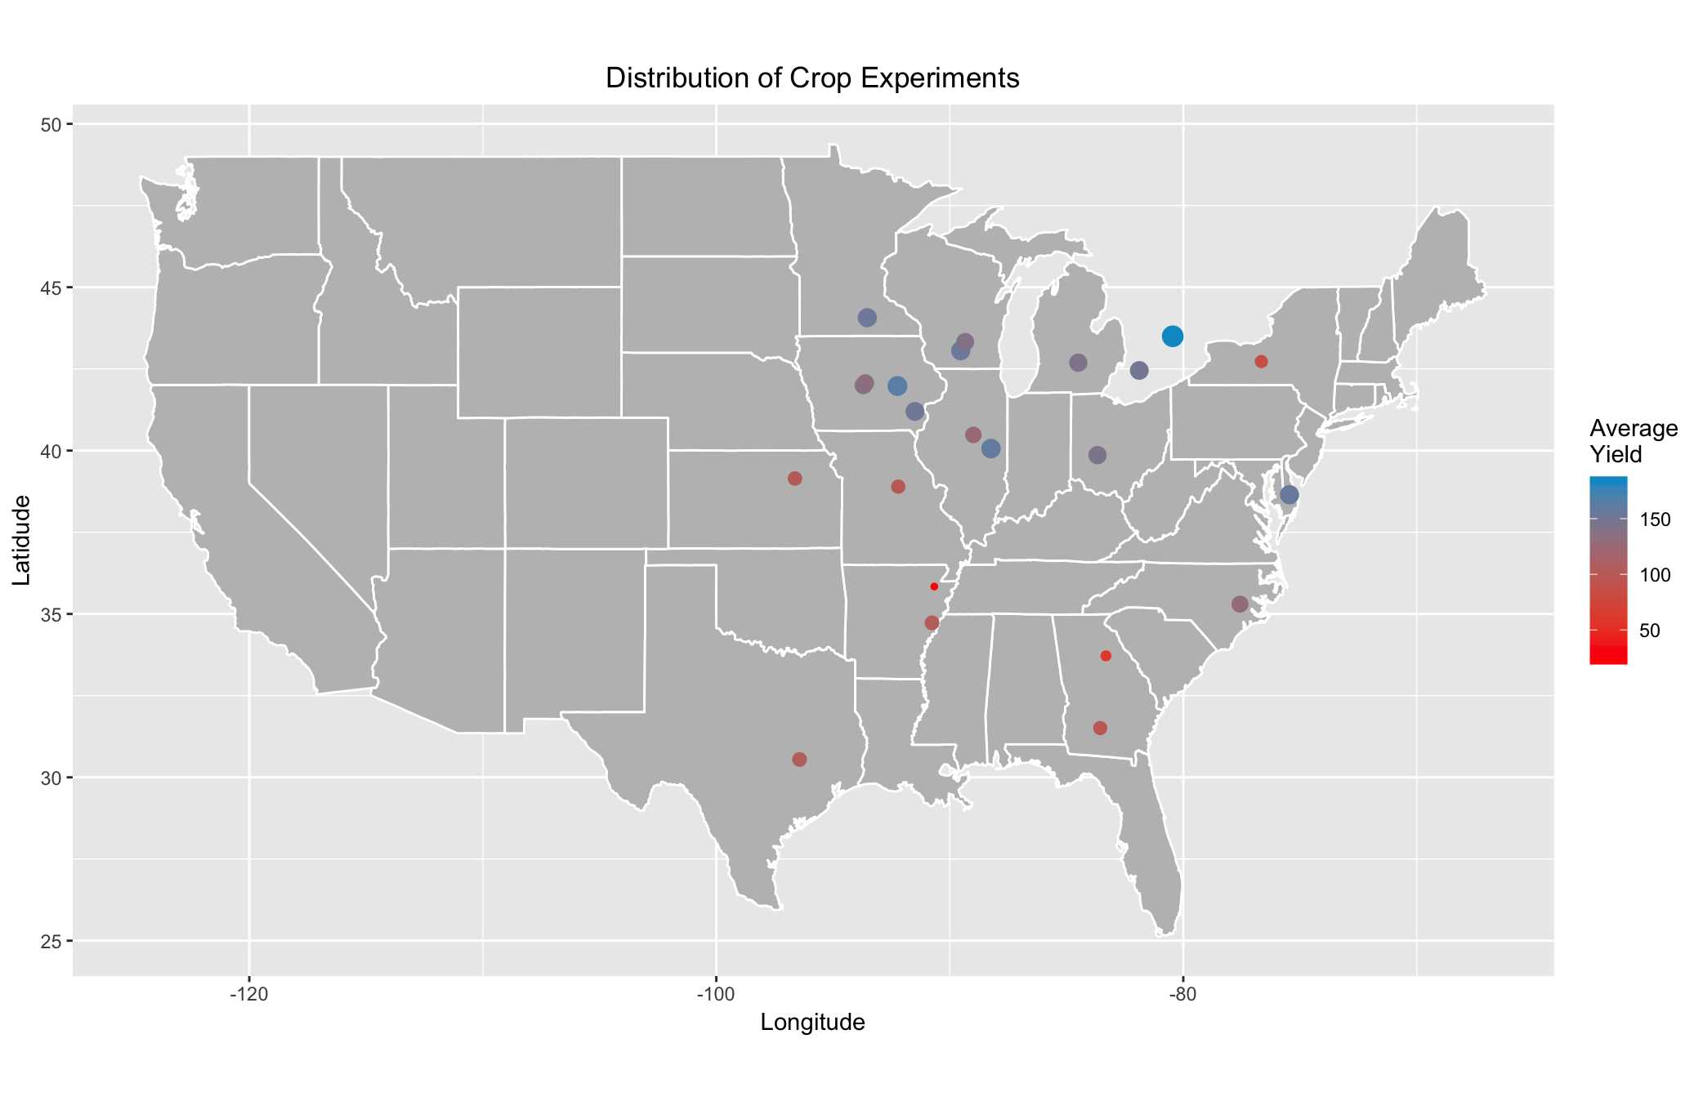
Envirotyping Packages – TACC EnviroTyping

Slide 19
Why Enviromics?
Provides new class of markers for genetic studies
Relatively inexpensive and transferable across species
More accurate selection of site-specific genotypes
Better definition of breeding areas with high genetic + environment correlation
Efficient identification of experimental sites
Improved information regarding disease and pest potential based on environmental factors

Slide 20
Primary Tools for Enviromics
Remote Sensing
Data source
Geostatistics
Verification
Data clean-up
GIS
Visualization
Mapping
Process-/Data-based Models
Analyses
Prediction

Slide 21

What is Remote Sensing?
“Remote sensing is the process of acquiring information about an object without actually being in contact with it.”
The most common application of Remote Sensing (RS) is for Earth Observation (EO)

Slide 22

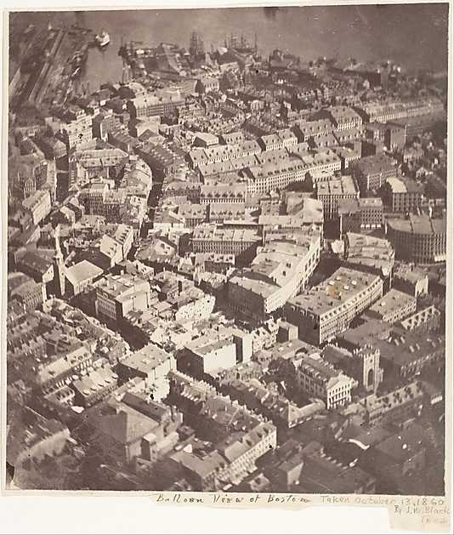
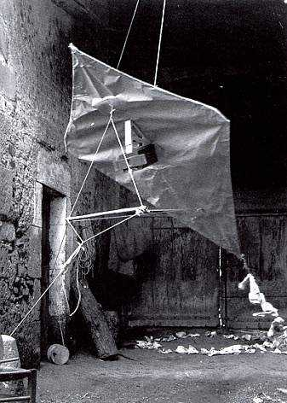
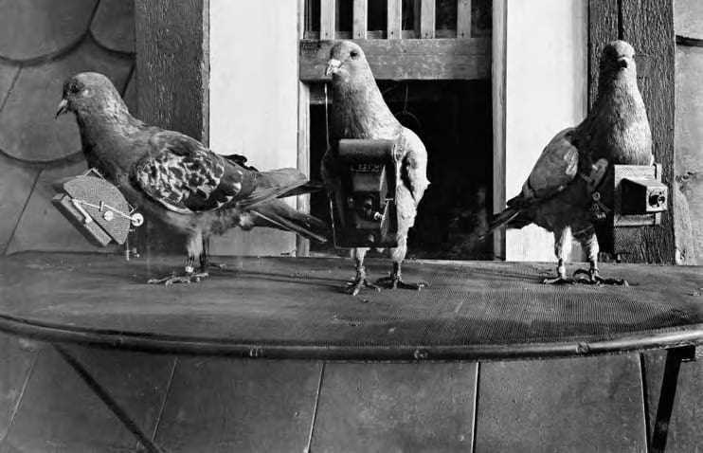

History of RS for EO
First aerial photograph was taken in 1858
Gaspard-Félix Tournachon
a.k.a. Nadar
“Boston, as the Eagle and the Wild Goose See It” by James Wallace Black. Photo: James Wallace Black / The Met

Slide 23
Types of Remote Sensing
Ground-based
Air-borne
Space-borne

Slide 24
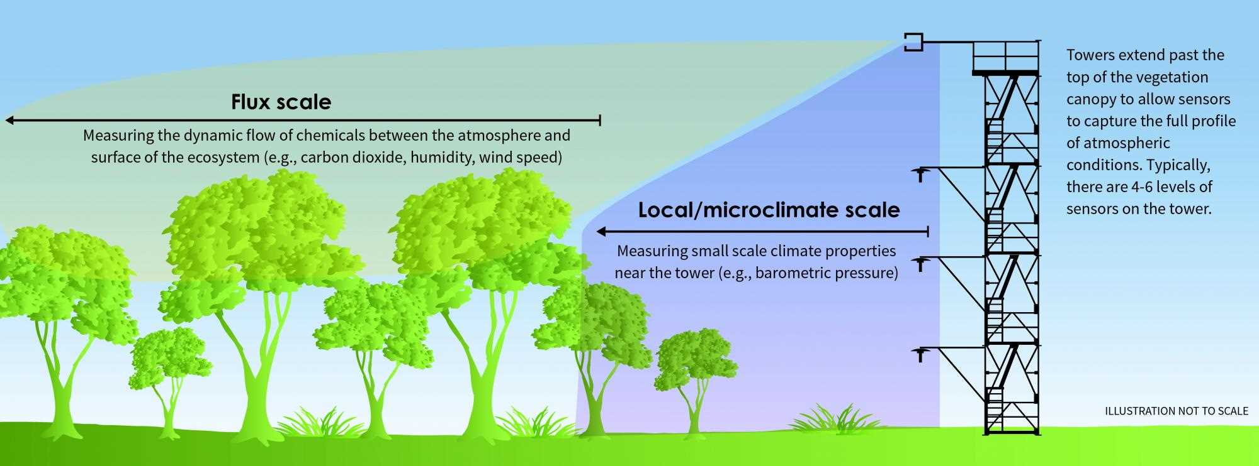
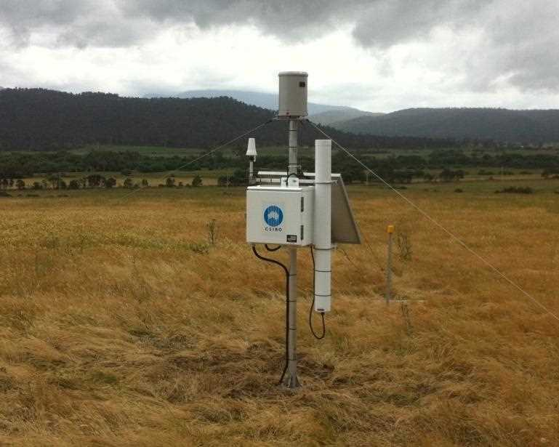
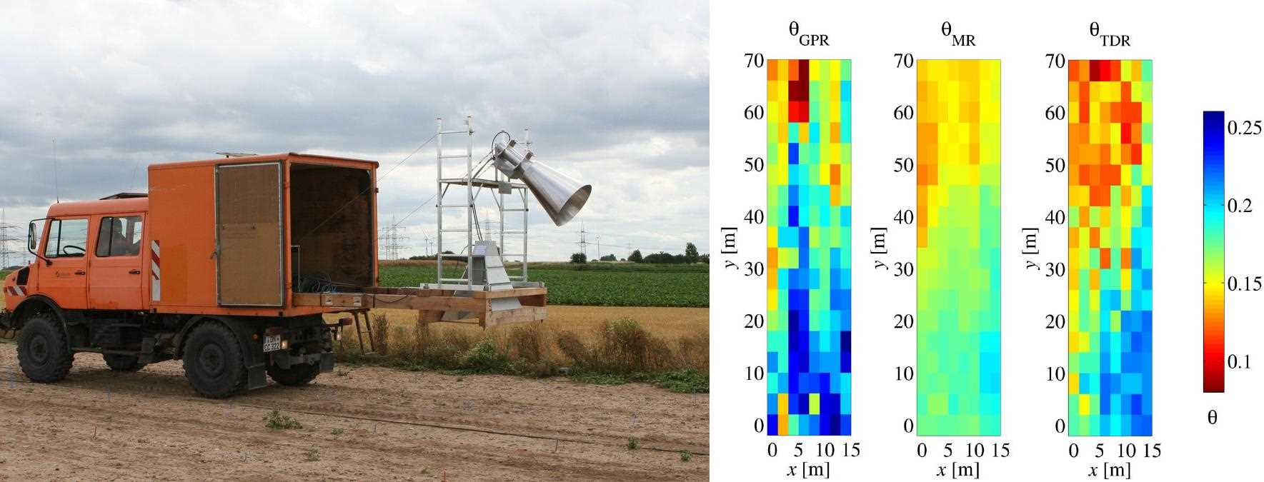
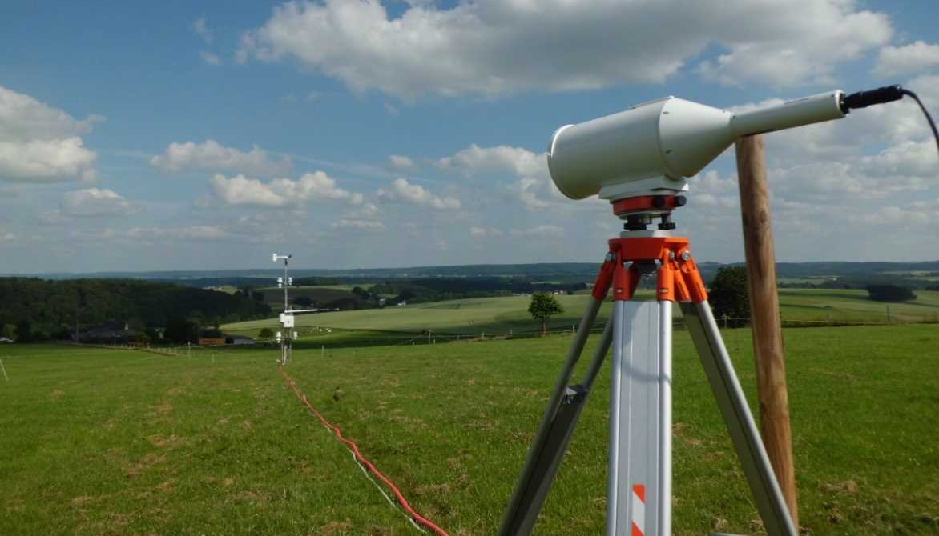
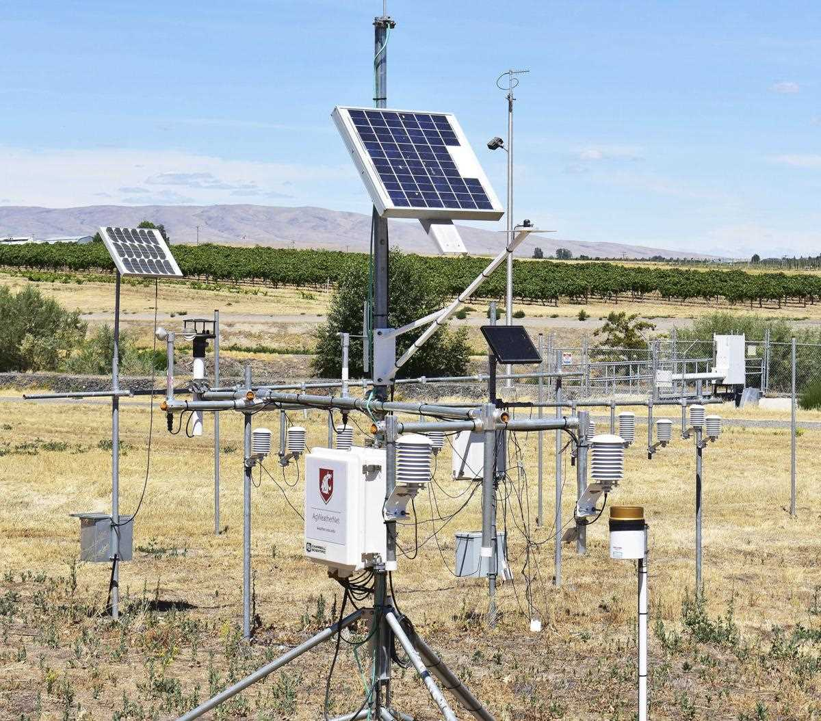

Slide 25
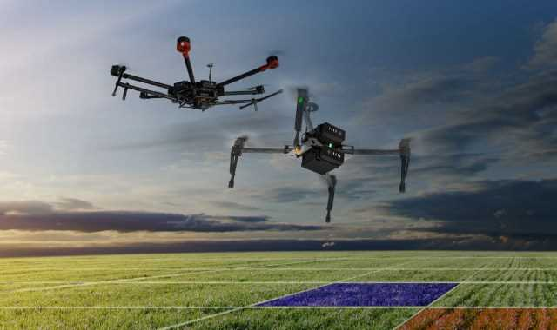




Slide 26
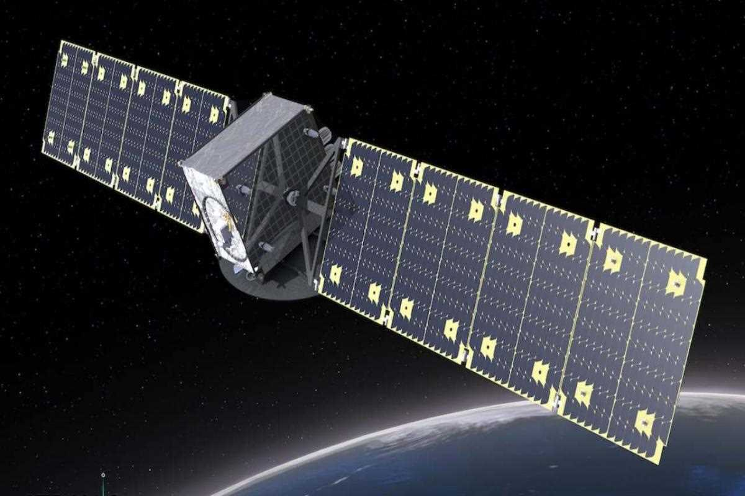
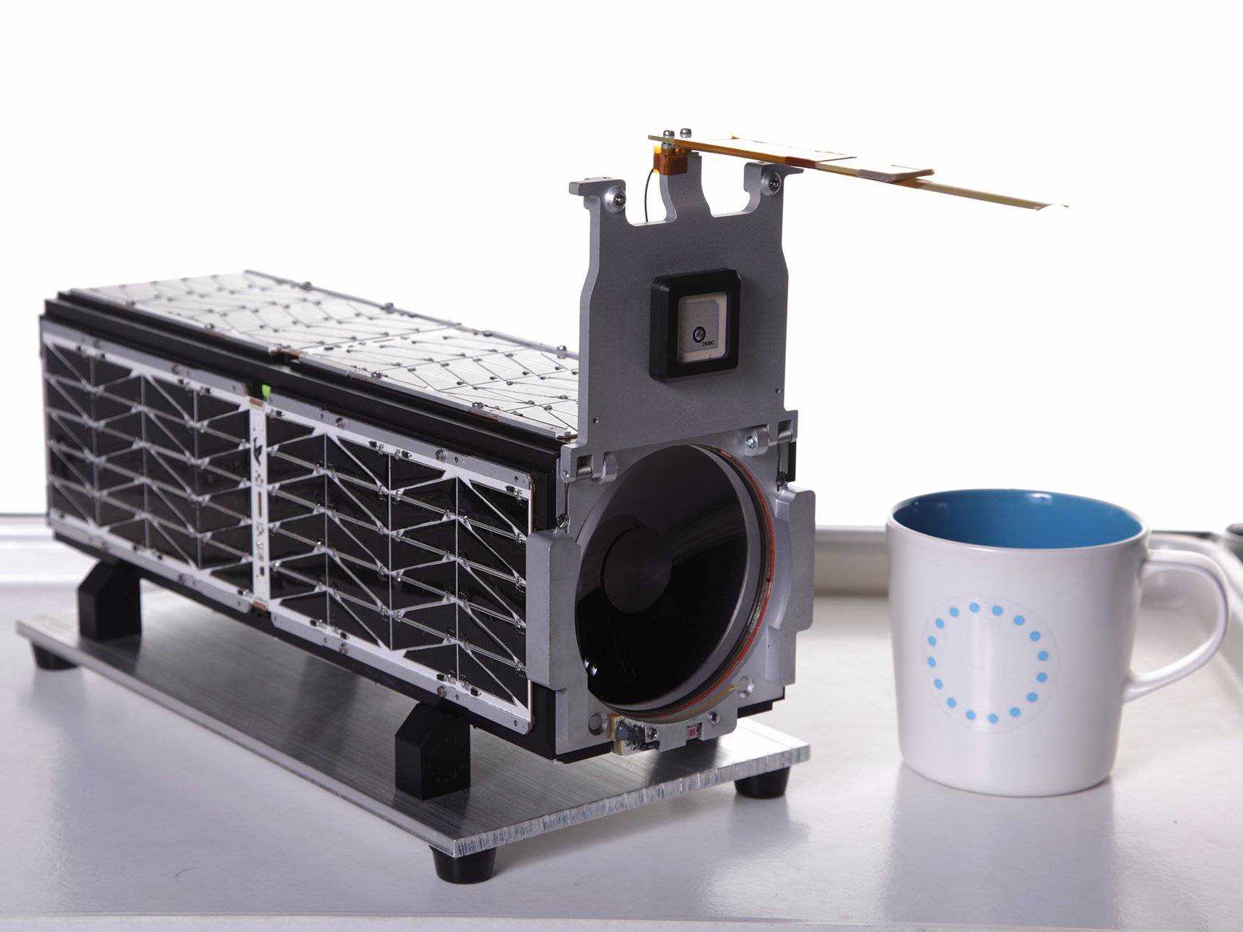
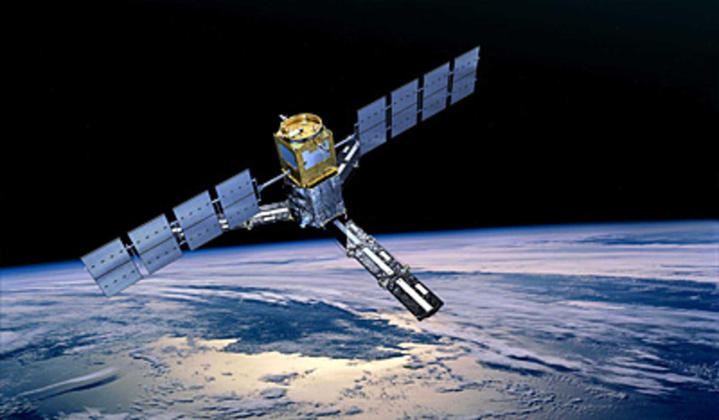
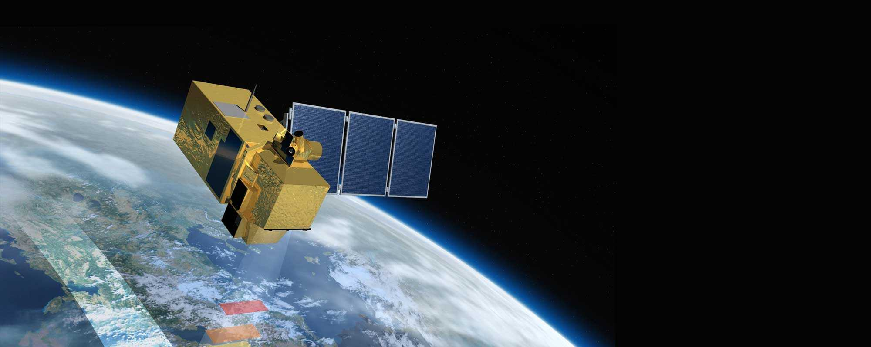
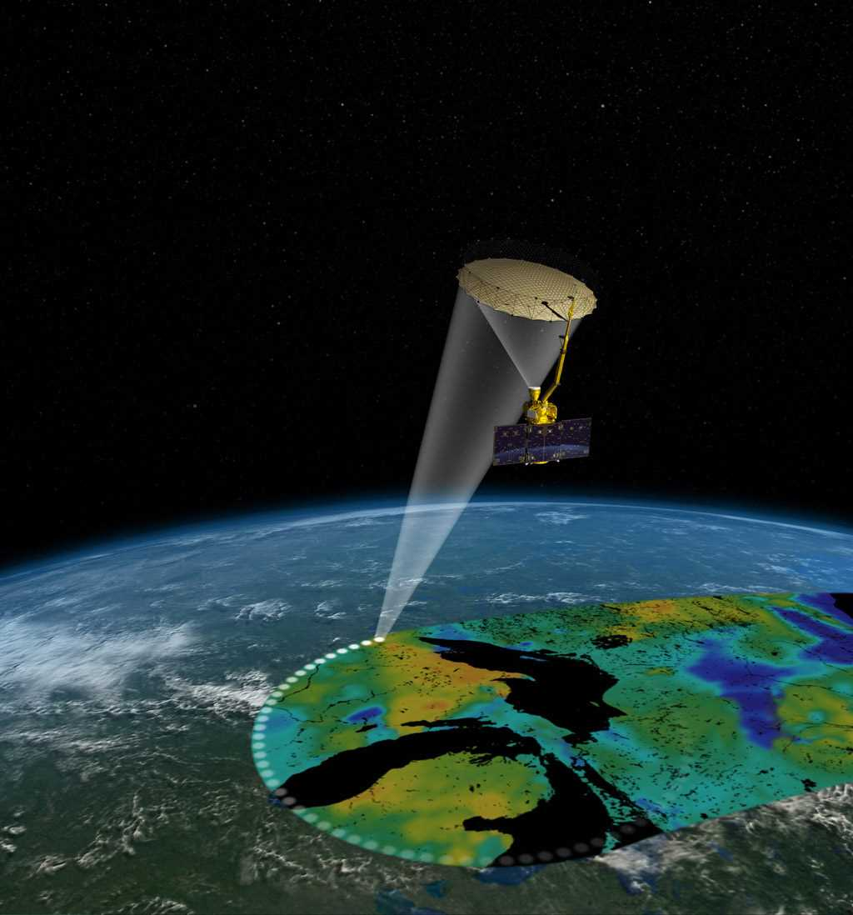
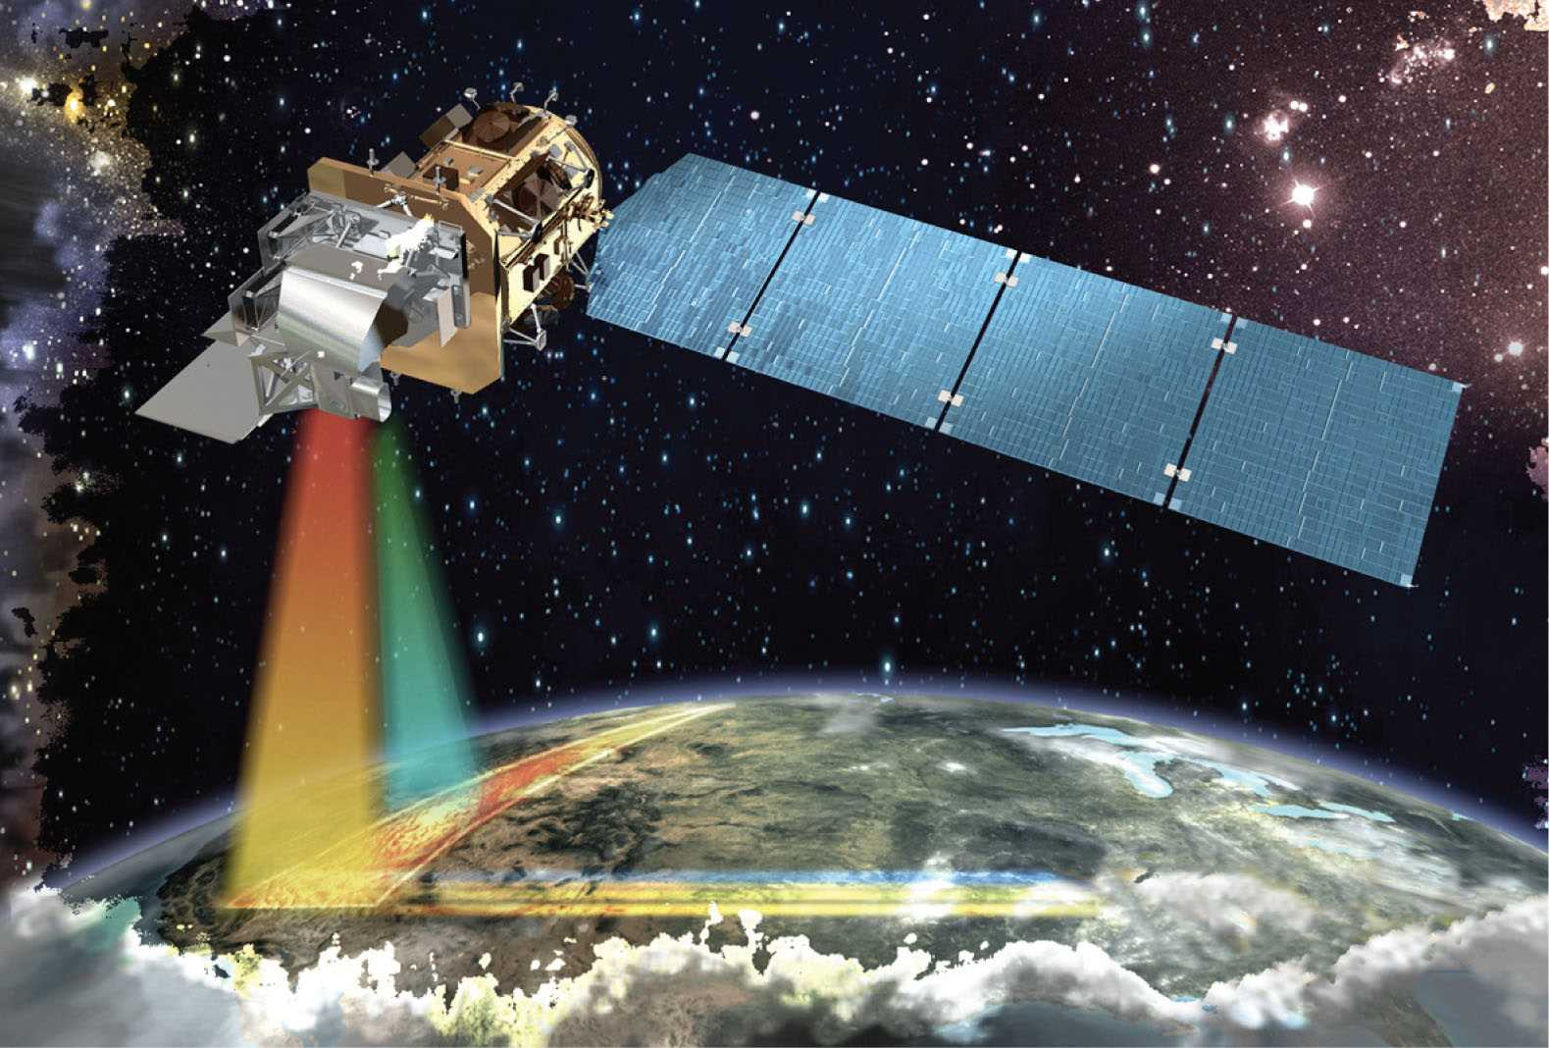
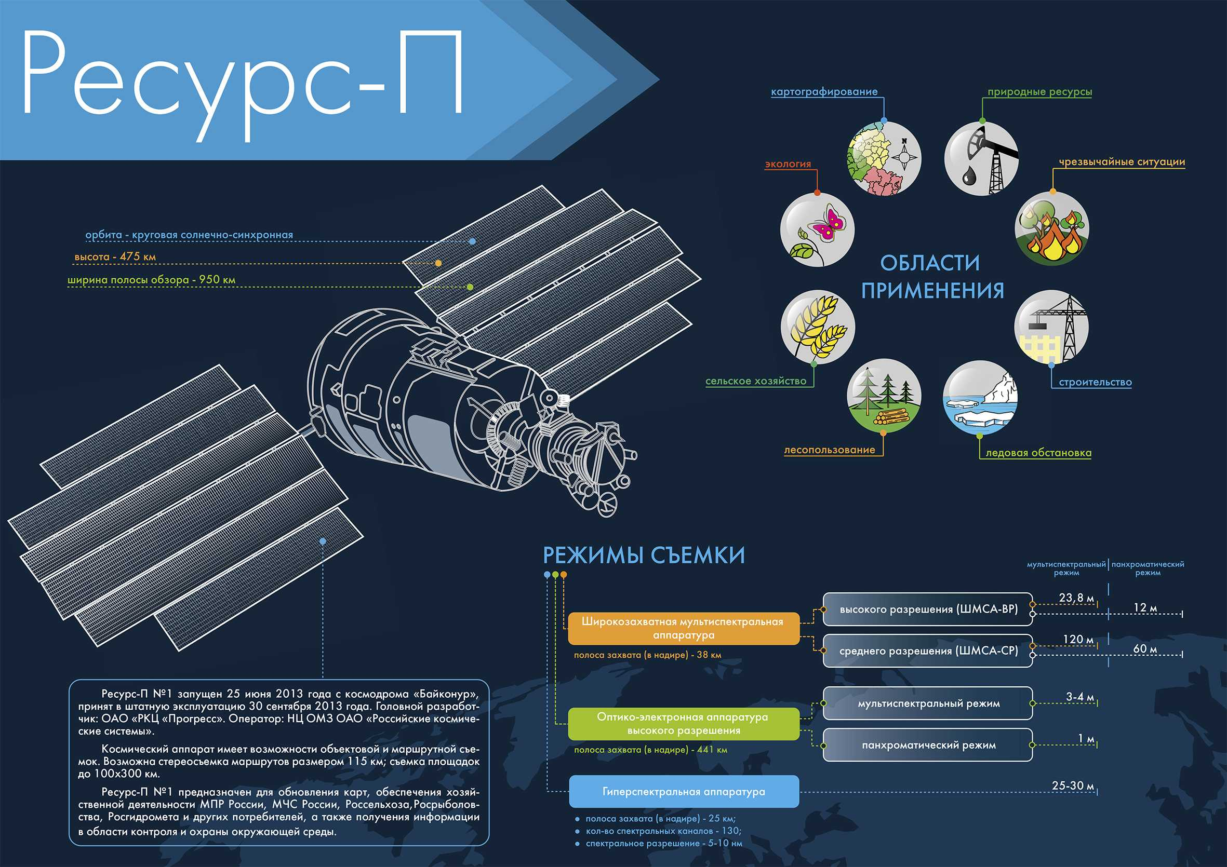
Notes:
SMAP, SMOS, Landsat, Sentinel, resursP, HySIS, cubesat

Slide 27
Types of Remote Sensors
Imaging Sensors
Optical
Thermal
Radar
Non-Imaging Sensors
Spectro-radio-meters
Radio-meters
Altimeter/Range-Finders

Slide 28
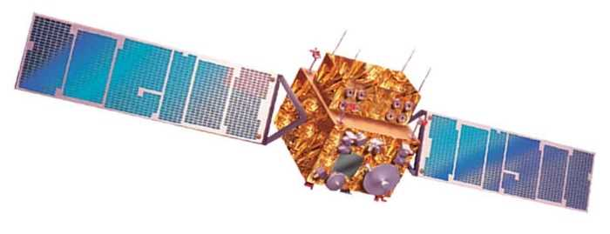

Passive Sensing
Sensing thermally emitted (natural) microwave radiation
Low energy level = coarse resolution

Slide 29

Active Sensing
Based on sensing reflected microwave radiation from own source emission
Finer resolution

Slide 30
Retrieval Algorithms
Convert measured quantity to parameter of interest
Brightness temperature to soil moisture
Reflectance to vegetation health
Precipitation
Salinity

Slide 31
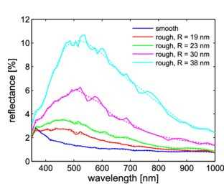
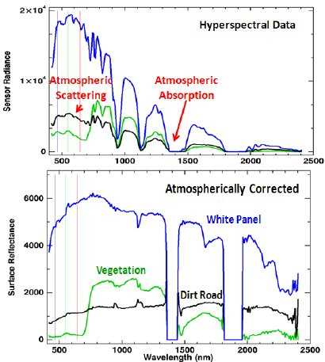
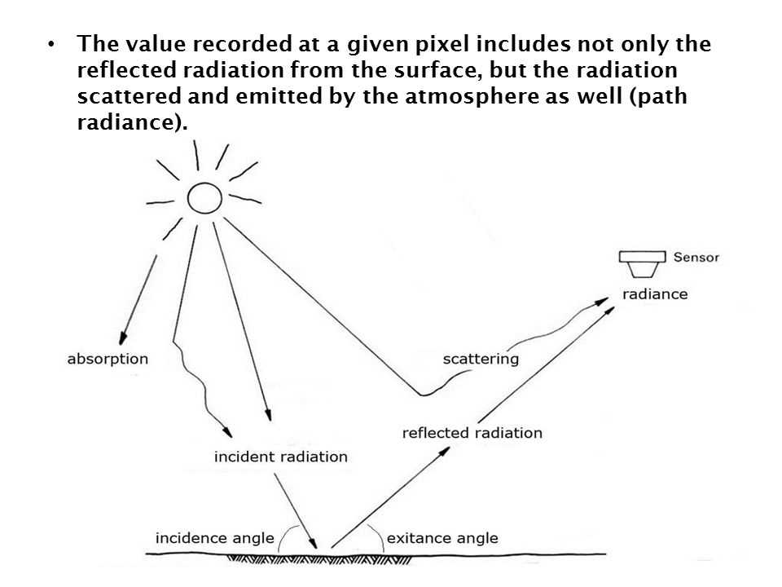
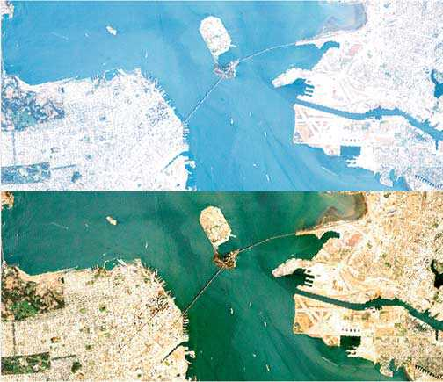
Retrieval Algorithms
Important to account for sources of variation and contamination
Atmosphere
Surface roughness
Chemical properties
Temperature
…
Steglich et al, 2014
Bernstein et al, 2012
Image: ORNL

Slide 32
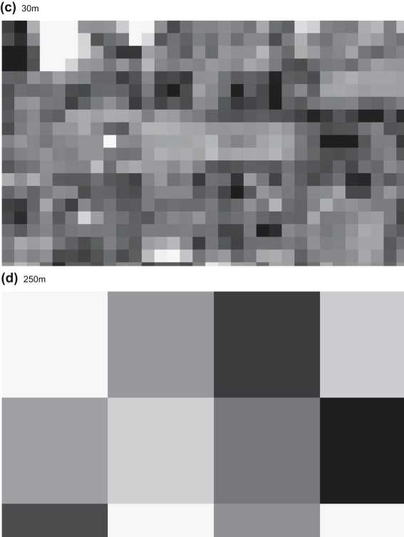
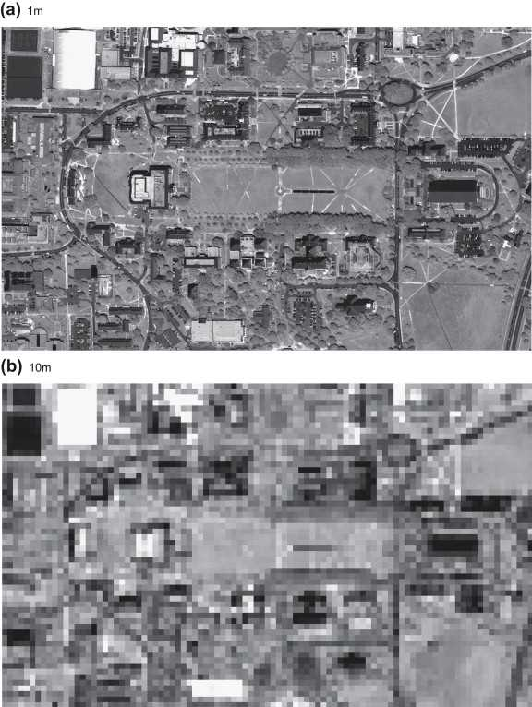
Resolution
Spatial
Temporal
Spectral
measure of the smallest object that can be resolved by the sensor
the linear dimension on the ground represented by each pixel
Notes:
250m, 30m, 10m, 1m

Slide 33
Resolution
Spatial
Temporal
Spectral
measure of the repeat cycle or frequency with which a sensor revisits the same part of the Earth’s surface
Sensor design
Orbit design
Spatial resolution
Scan width
Orbital path
Orbit speed

Slide 34
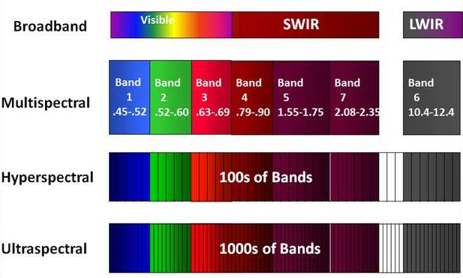
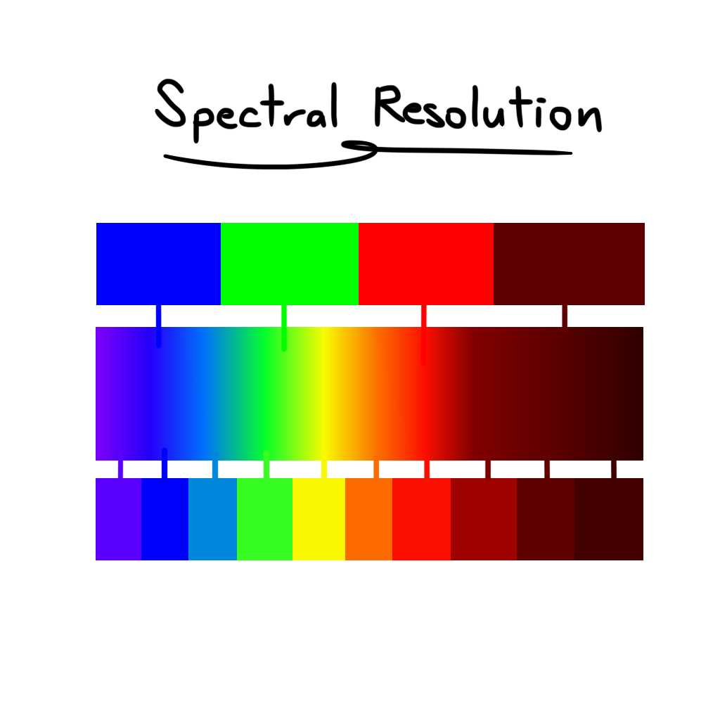
Resolution
Spatial
Temporal
Spectral
the number and width of spectral bands in a sensor system

Slide 35
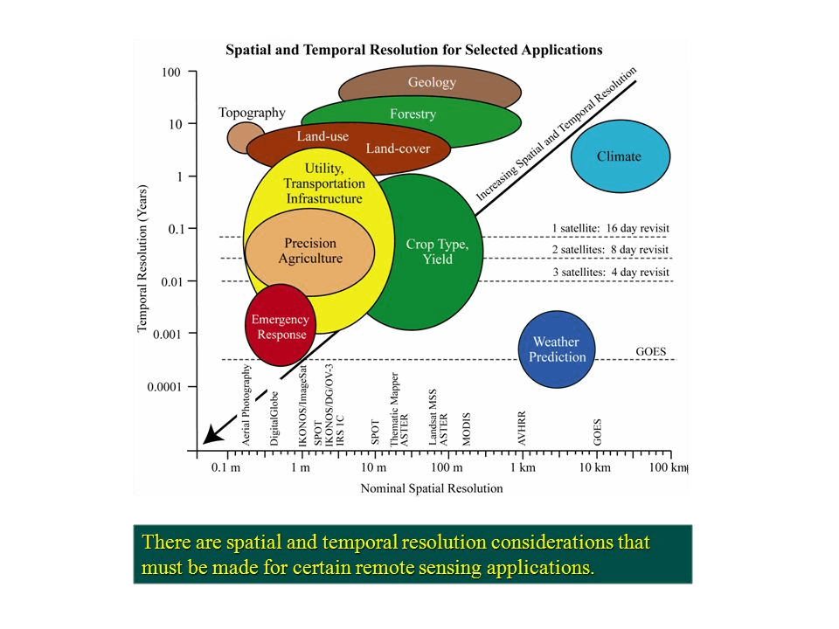
Resolution and Application

Slide 36
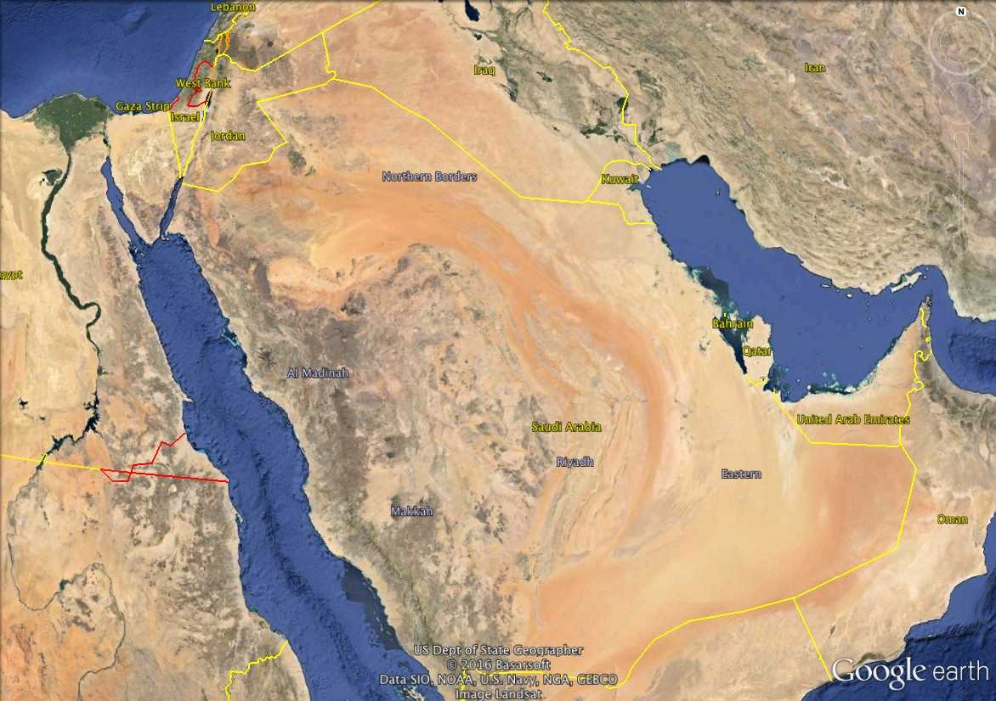
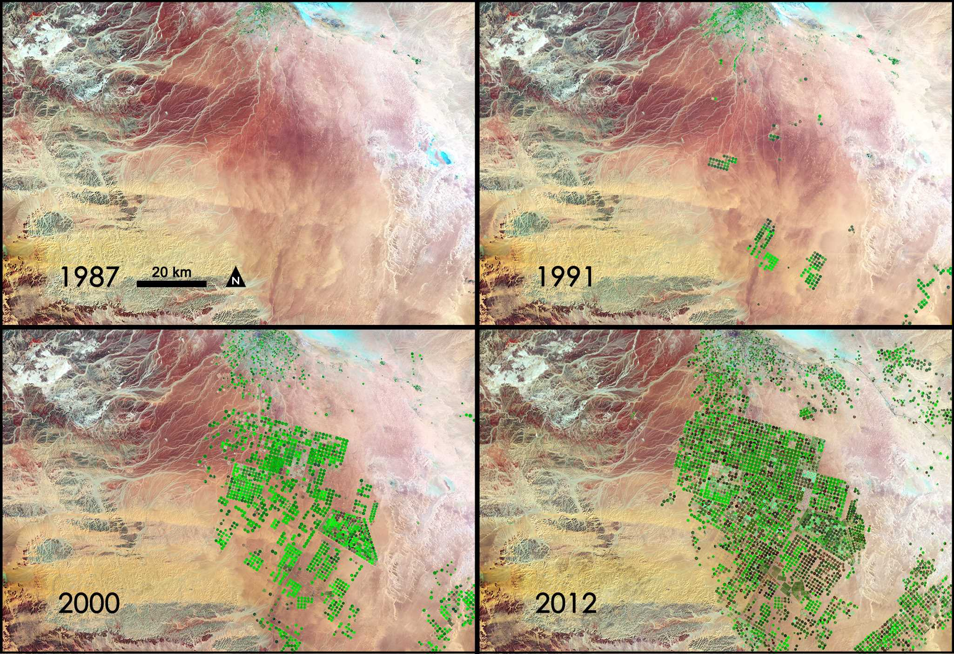
http://www.nasa.gov/topics/earth/features/saudi-green.html
Notes:
This is only the amount of water actually required by the plant… over this, we have evaporation from ground surface, wastage by over-watering, runoff, etc

Slide 37
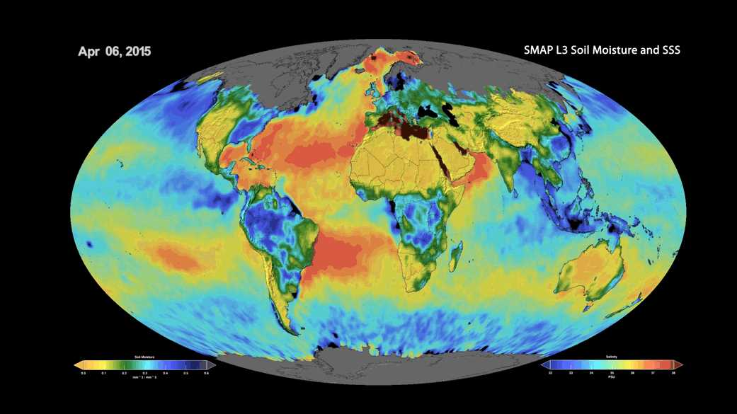
Soil Moisture Observation

Slide 38
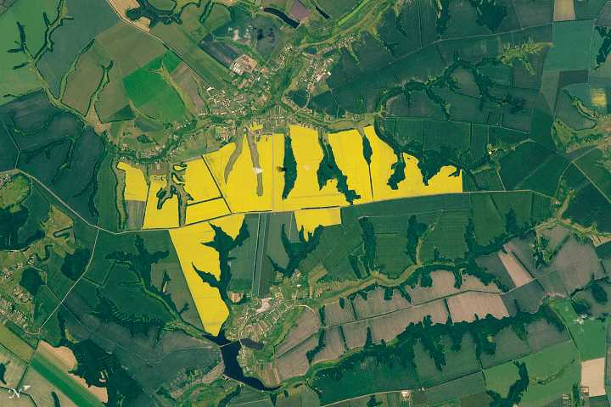
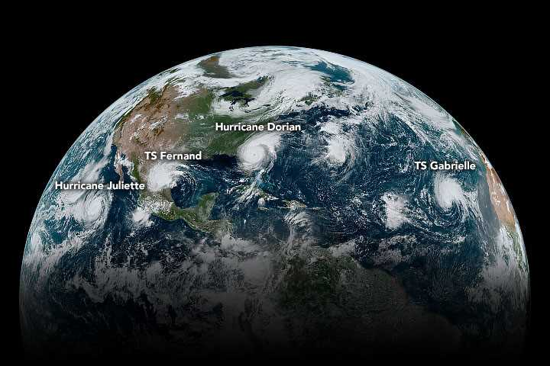
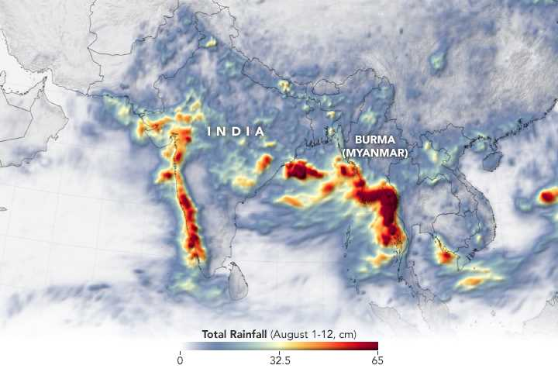





Monsoon floods in south-
east Asia. Aug 2019
Air pollution in north
India. Nov 2019
May 2018
Jun 2019
Turbulent weather in the
Western hemisphere. Sep 2019
Rapeseed flowers, Kursk Oblast, Russia. Jun 2017
Notes:
Puzhal lake capacity is 93 M m3

Slide 39

Spectral Reflectance

Slide 40


Spectral Reflectance - Leaf

Slide 41

Disease Identification

Slide 42



Classification of Crops

Slide 43

Classification of Crops
Different crops have different reflectance levels at different growth stages

Slide 44

Classification of Crops
Different crops have different reflectance levels at different growth stages

Slide 45

Indices
Galieni, A., D’Ascenzo, N., Stagnari, F., Pagnani, G., Xie, Q., & Pisante, M. (2021). Past and Future of Plant Stress Detection: An Overview From Remote Sensing to Positron Emission Tomography. Frontiers in Plant Science, doi: 10.3389/fpls.2020.609155

Slide 46

NDVI

Slide 47


NDVI

Slide 48


Crop Health
Huang, et al., Crop Disease and Pest Monitoring by Remote Sensing

Slide 49
Challenges
Cloud cover
Instrument reliability
Retrieval algorithms
Resolution

Slide 50




Repairing Satellite Imagery
Instrument failure on-board
Clouds/other artefacts

Slide 51

Repairing Satellite Imagery
Time Series
 | Jan | Feb | Mar | Apr | May | Jun | Jul | Aug | Sep | Oct | Nov | Dec | Year
Clear | 8 | 9 | 10 | 8 | 11 | 7 | 8 | 10 | 8 | 5 | 3 | 4 | 82
Partial | 11 | 10 | 13 | 17 | 16 | 20 | 20 | 17 | 16 | 13 | 9 | 10 | 184
Cloudy | 12 | 9 | 9 | 5 | 4 | 3 | 4 | 4 | 6 | 12 | 18 | 17 | 98

Slide 52
Primary Tools for Enviromics
Remote Sensing
Data source
Geostatistics
Verification
Data clean-up
GIS
Visualization
Mapping
Process-/Data-based Models
Analyses
Prediction

Slide 53



Why Geostatistics?
Objective: characterization of spatial systems that are incompletely known
Exact description of system is neither feasible nor economically possible
Geostatistics uses the location of every measurement
Measurements need to be spatially correlated
The results are necessarily uncertain
Notes:
Ordinarily the need for additional knowledge goes beyond a few points, which explains the display of results graphically as fishnet plots, block diagrams, and maps.
uncertainty is not an intrinsic property of the systems; it is the result of incomplete knowledge by the observer

Slide 54
Geo vs Classical Statistics
Geostatistics is not tied to a population distribution model
No assumptions of normality, independence, etc.
Spatial correlation – data values from locations that are closer together tend to be more similar than data values from locations that are further apart
Classical: Statistical distribution of sample data
Geo: Statistical distribution + spatial correlation

Slide 55
Spatial Autocorrelation
Based on Tobler’s first law of geography –
“Everything is related to everything else, but near things are more related than distant things”
It’s the correlation of a variable with itself through space (only 1 variable is involved)
Patterns may indicate that data are not independent of one another, violating the assumption of independence for some statistical tests

Slide 56
Spatial Autocorrelation
Notes:
Each dot represents 25km

Slide 57
Spatial Autocorrelation
Allows answering the following questions about your data:
How are the features distributed?
What is the pattern created by the features?
Where are the clusters?
How do patterns and clusters of different variables compare to one another?

Slide 58

Spatial Autocorrelation
Measure the
pattern formed by the location of features
or
patterns of attribute values associated with features (ex. median home value, percent female, etc.)

Slide 59
Other Metrics
Spatial Neighborhoods
Distance Models
Distance Measures
Adjacency Models
Contiguity
…

Slide 60
Global vs. Local Statistics
Global statistics – identify and measure the pattern of the entire study area
Do not indicate where specific patterns occur
Local Statistics – identify variation across the study area
focus on individual features and their relationships to nearby features (i.e. specific areas of clustering)

Slide 61
Moran’s I
Measure of Spatial Autocorrelation
Global statistic
Measures whether the pattern of feature values is clustered, dispersed, or random
Compares the difference between the mean of the target feature and the mean for all features to the difference between the mean for each neighbor and the mean for all features

Slide 62
Moran’s I
Mean(T) – Mean(G)
Global Mean
Mean(N1) – Mean(G)
Mean(N2) – Mean(G)
Neighborhood
Mean(N3) – Mean(G)
Target Feature
.
.
.
Mean(N8) – Mean(G)

Slide 63
Moran’s I
Moran’s I = -1
Moran’s I = +1

Slide 64
Spatial Regression
Spatial data often do not fit traditional, non- spatial regression requirements because they are:
spatially auto-correlated (features near each other are more similar than those further away)
nonstationary (features behave differently based on their location/regional variation)
No spatial regression method is effective for both characteristics

Slide 65

Ordinary Least Squares (OLS)
Best known linear regression technique
Good starting point for all spatial regression analyses
Global model
Provides 1 equation to represent the entire dataset

Slide 66
Other Linear Regression Techniques
Globally Weighted Regression (GWR)
Spatial Lag Model
Spatial Error Model
…

Slide 67

Kriging
Also known as Gaussian Process Regression (GPR)
Linear or Non-linear regression
Sub-types
Ordinary Kriging
Simple Kriging
Universal Kriging
Co-Kriging
…

Slide 68

Kriging
Used for spatial interpolation
Honors observations in 2D

Slide 69

Semivariogram

Slide 70

Semivariogram
Circular
Spherical
Tetraspherical
Pentaspherical
Exponential
Gaussian
Rational Quadratic
Hole Effect
K-Bessel
J-Bessel
Stable
…

Slide 71
Primary Tools for Enviromics
Remote Sensing
Data source
Geostatistics
Verification
Data clean-up
GIS
Visualization
Mapping
Process-/Data-based Models
Analyses
Prediction

Slide 72
What is GIS?
Geographical Information System
Deals with Spatial Data
Any data that can be mapped
Location coordinates, shapes of geographic features, etc.

Slide 73










Spatial Data
55.685201° N, 37.342367° E
Plan of the imperial capital city of Moscow designed under the supervision of architect Ivan Michurin in 1739. Copper plate engraving. From the Museum of Moscow’s collection.

Slide 74




Spatial Data – Layers
With GIS, you can digitally represent geographic objects with a variety of shapes and layer those shapes on top of one another to create maps and perform analysis

Slide 75
Spatial Data Formats
Vector
Tabular
Raster

Slide 76


Vector
Represent information using points, lines, and polygons

Slide 77

Raster
A model of the world as a surface that is divided into a regular grid of cells,
Row and column matrix
All cells (or pixels) must be the same size
All cells have a value
Cell

Slide 78

Data Representation
Real-world spatial information can be represented in either vector or raster formats
Transition between vector and raster, and back, is technically possible, but not easy in most situations
Image by MIT OpenCourseWare

Slide 79


Tabular
Spatial data have a backend database called an attribute table
It can be used for querying and analysis
All attributes can be mapped

Slide 80

Hands-on with Google Earth Engine

Slide 81
Primary Tools for Enviromics
Remote Sensing
Data source
Geostatistics
Verification
Data clean-up
GIS
Visualization
Mapping
Process-/Data-based Models
Analyses
Prediction

